Slide 1
Docker Delight
Unlocking the Power of Containerization And what does it have to do with food?

Slide 2
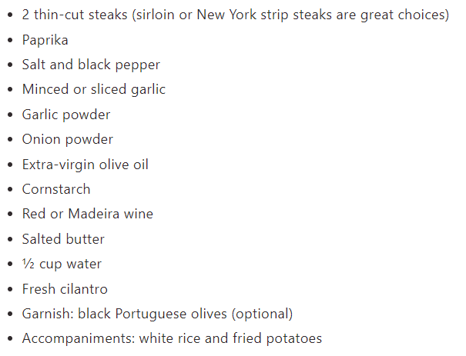
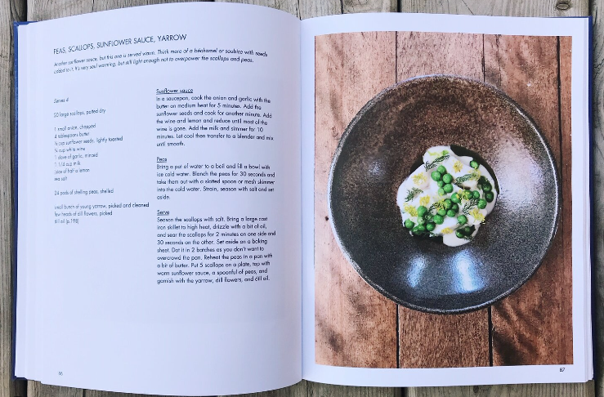
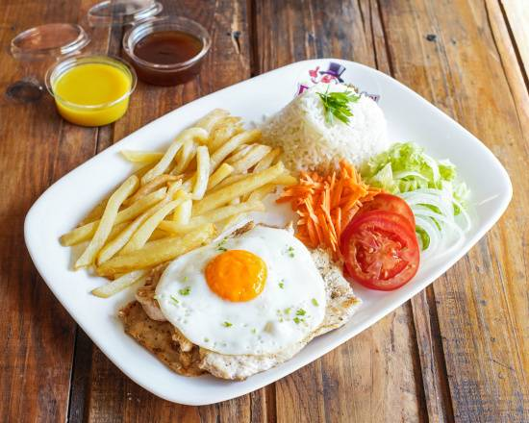
Docker vs food
Recipe -> Dockerfile + Image
Food -> App + dependencies
Cookbook -> Registry
Plate -> Container
Table -> Host

Slide 3
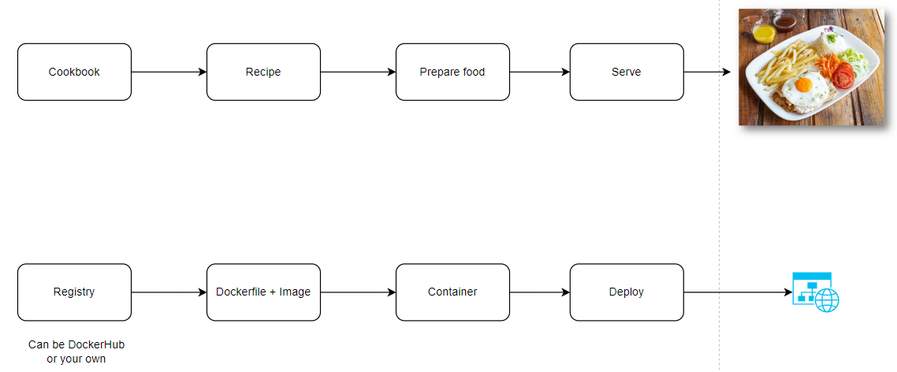
Creating a container

Slide 4
Demo time
Notes:
Food with no plate
-> More food coming to the table
-> Dependencies mixing up
-> Windows update messing everything up

Slide 5
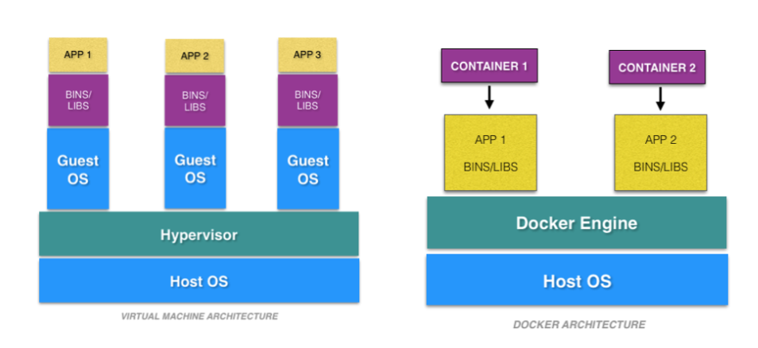
Containers vs VMs
Notes:
Ask: who thinks that this looks a lot like VMs?

Slide 6
Containers vs VMs
Performance
Spinning up a new container is duplicating your plate
Spinning up a new VM is having a single meal and duplicating the whole table
Scalability
New containers are fast to create
New VMs take a long time to create
Resource Optimization
Containers need way less resources (space, memory, cpu)
VMs run a whole OS
Isolation
Containers run as a process on the host
VMs run as if they were a full machine

Slide 7
What are the benefits of having a plate?
Isolation
Scalability
Performance
Resource optimization
Notes:
What happens over time when you don’t have a container?

Slide 8
Demo time
Notes:
What happens over time when you don’t have a container?

Slide 9
Containers vs VMs

